Slide 1
Docker

Slide 2
What is Docker?
Docker is tool for building, distributing and running containers.
Containers are running instances of an image.
An image is built from set of instructions and commands usually given in a Docker file(image is a executable version application).
Docker file is usually a file which has commands and arguments to create an image.

Slide 3
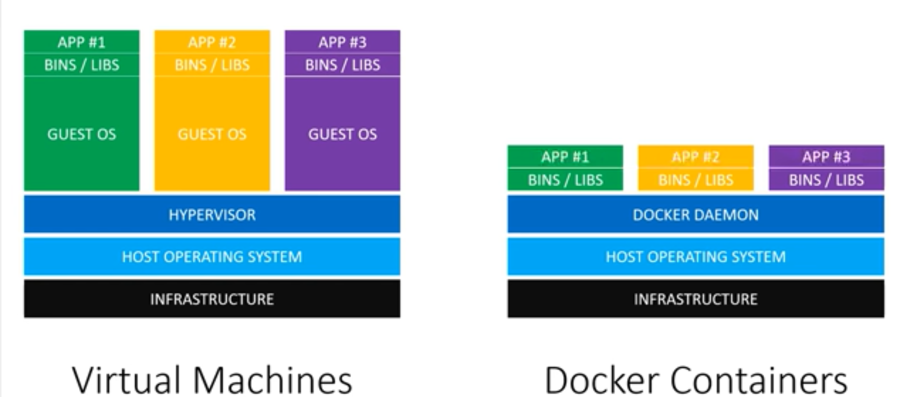
Why Docker?
To remove the problem occurring when run in different environments(i.e to achieve Write once run anywhere).

Slide 4
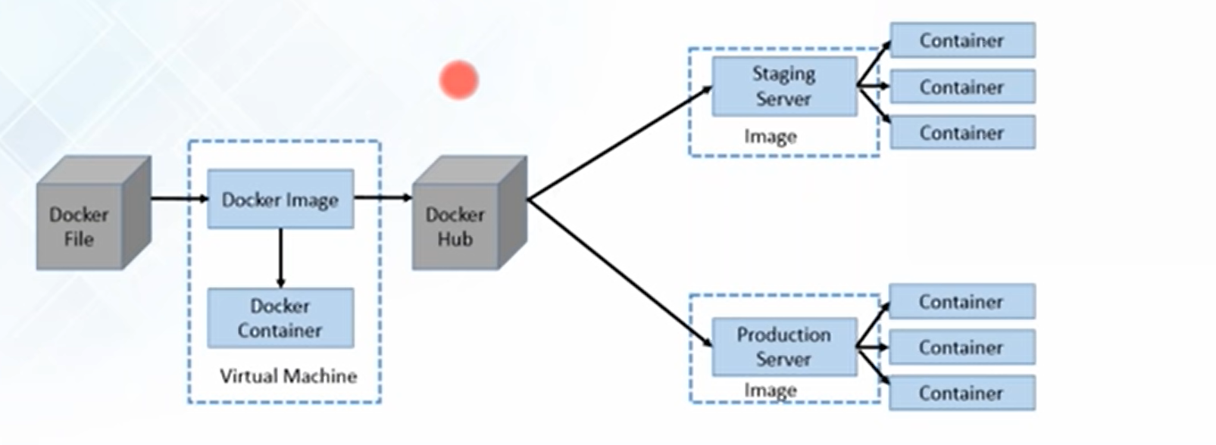
Working of Docker

Slide 5
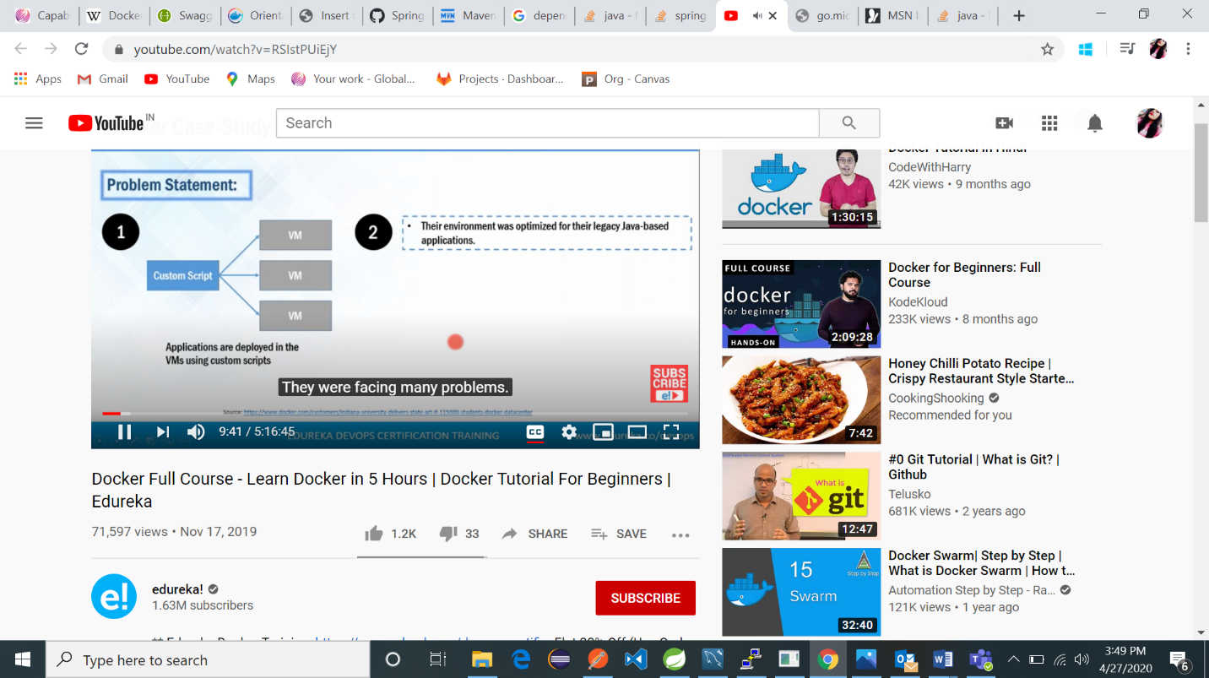
Adaptation of Docker in Industries

Slide 6
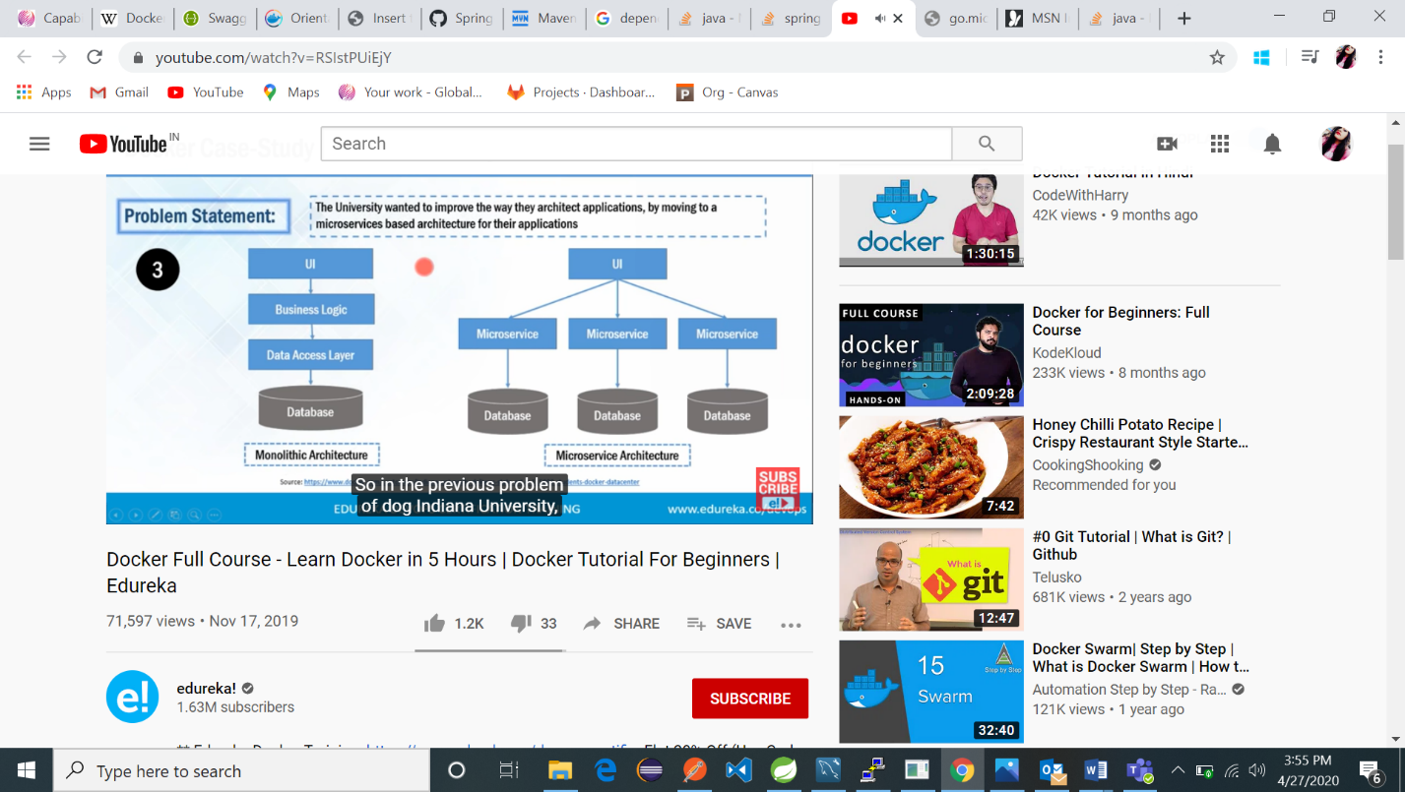

Slide 7
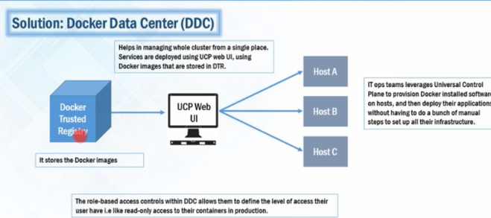
Solution For this problems:

Slide 8
As we saw in the previous slides, the industries wants to switch from monolithic architecture to micro service architecture,so the docker image contains the dependencies of only one particular micro service not the whole application.
Universal control panel: It helps to deploy host on various hosts with the help of Docker images present in the Docker Trusted registry.
So the operation teams can image the entire infra structure from a single place with the help of UCP UI.
It reduces the manual steps which is used before Docker came in the market(in order to deploy in the Vms).

Slide 9
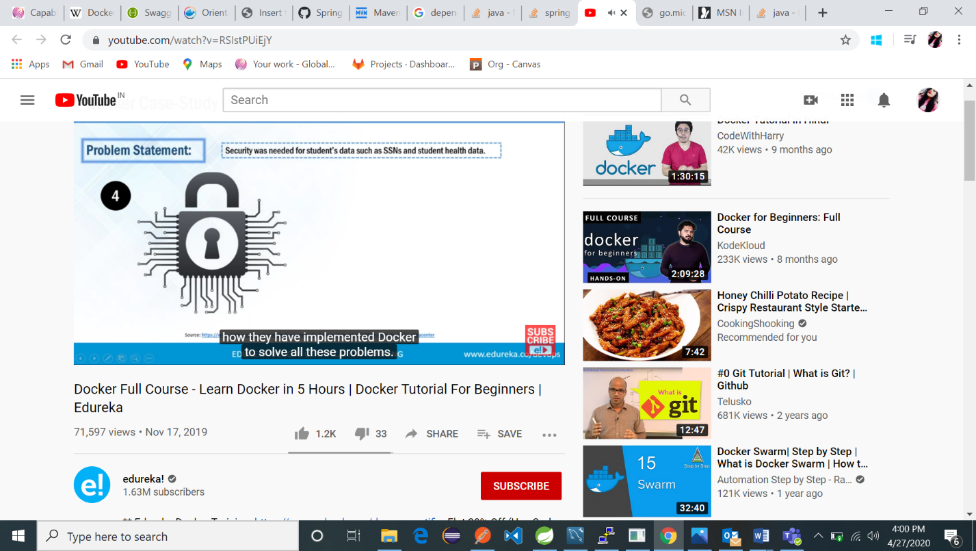
Docker in security
Read Only Access of Docker Containers for the production team
Read and Write access for the Deputy team.

Slide 10
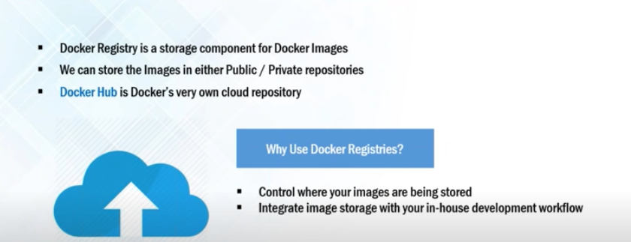
Components of Docker:

Slide 11
Docker Registry : All the docker images stored in the docker registry and these images are either present in the public or private repositories.
These repositories present locally or in the clouds.
Docker Provides the cloud hosted service called docker Hub.
So from the public repository we can pull a image and can make our own container
And also we can write the image and upload that on the docker hub in public as well as private repository.

Slide 12
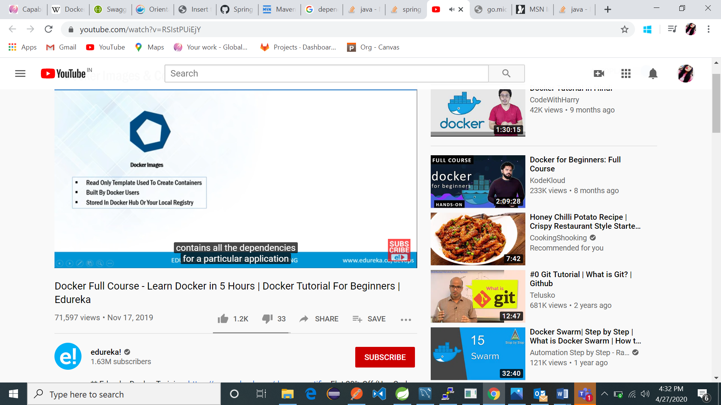
Docker Image:
It is the read only templets which contains all the dependencies requires for a particular application
We can create our own images and upload in the docker hub and at the same time we can pull the images available in the private and public repository as well.

Slide 13
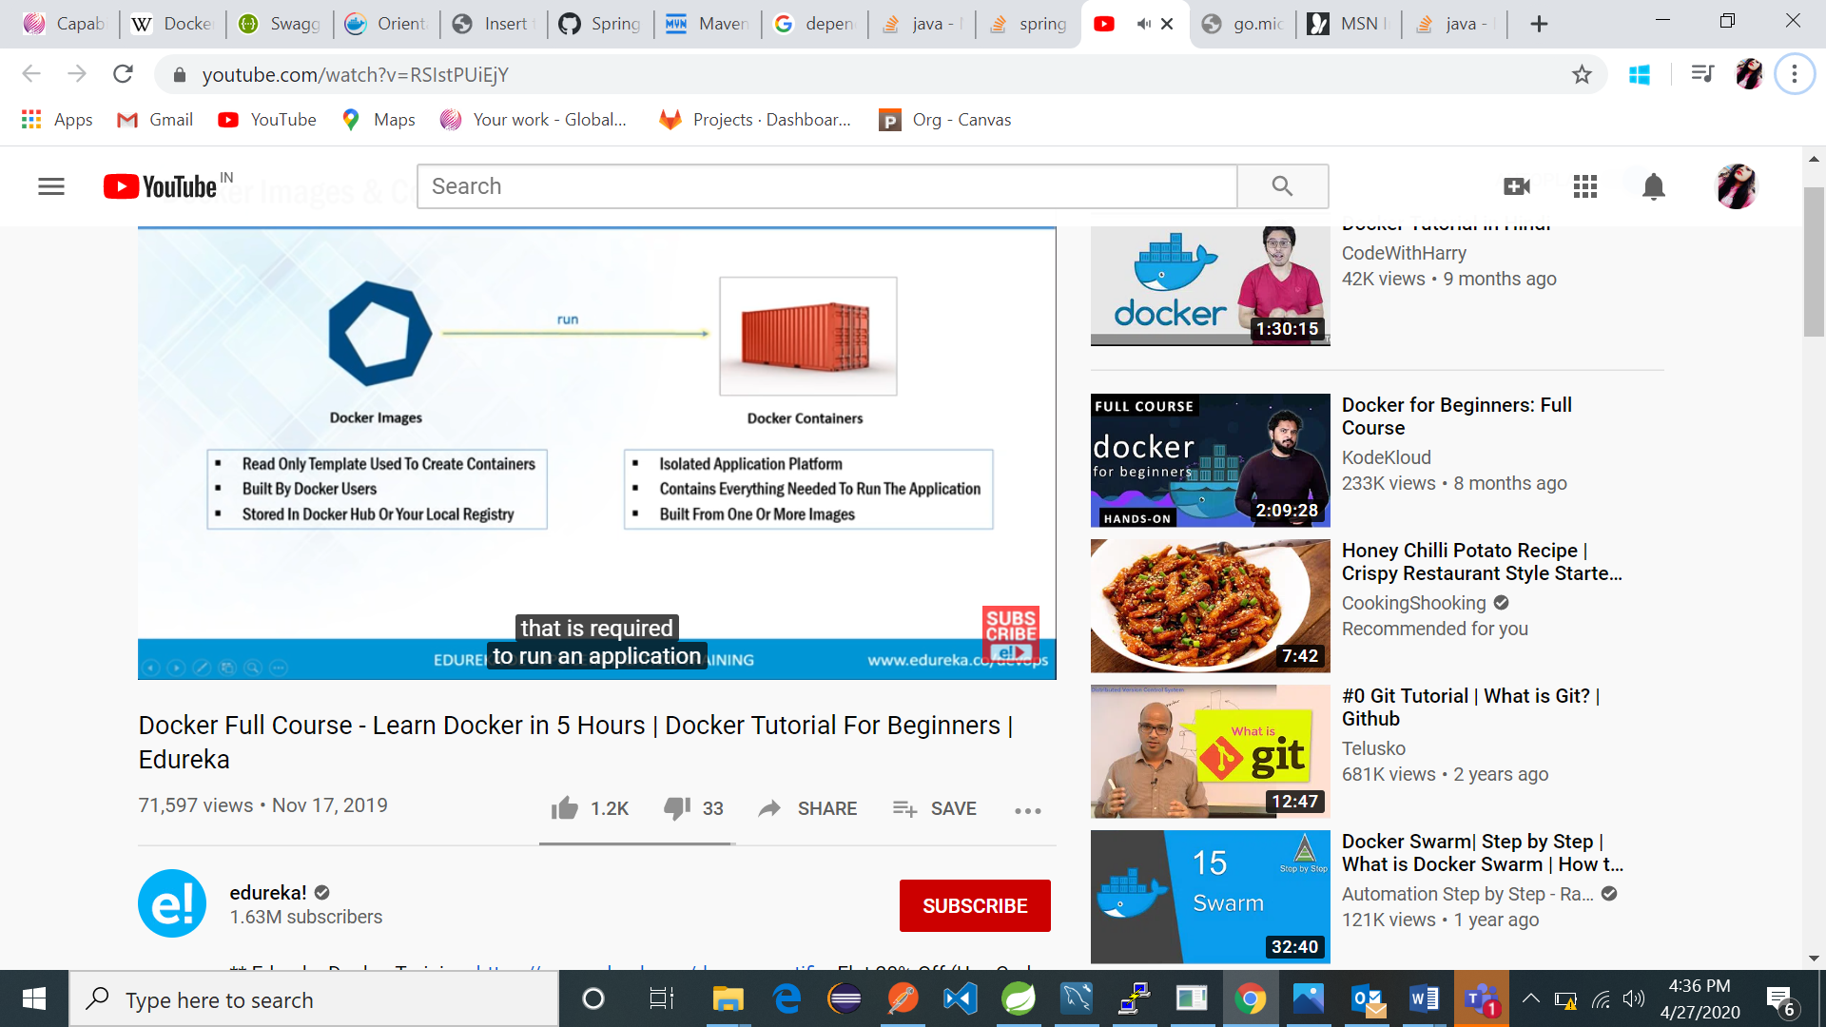
Docker container:

Slide 14
Continued
It is the runtime instances of docker images and have every thing to run an application
. The use of containers to deploy applications is called containerization.
Containers are isolated from one another and bundle their own software, libraries and configuration files so that they can communicate with each other through well-defined channels.

Slide 15
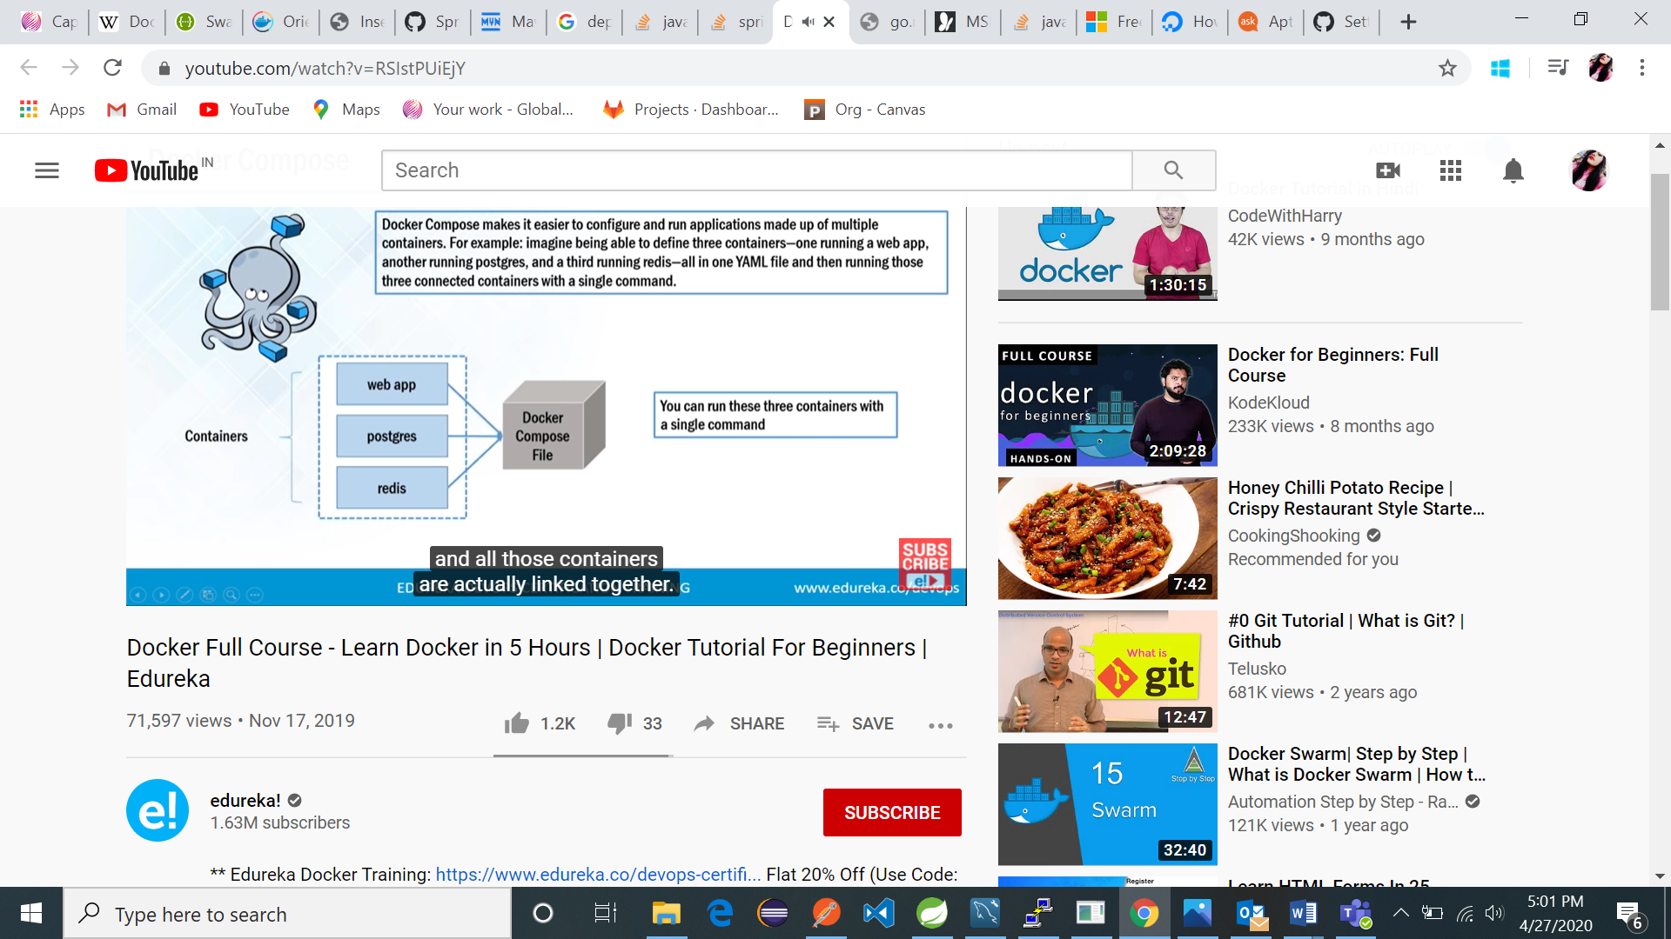
Docker Compose:

Slide 16
Suppose, we have multiple containers in various applications and all those containers are linked together and we don’t want to execute all the containers one by one instead we want to execute the all the containers at onces by a single container, so we need docker compose.

Slide 17
Thank you

